Slide 1

TOPIC 3
Decisions Over Time
SECTION 1
The Single-Person Decision Problem
Games
TOPIC 1
The Rational Choice Paradigm
Class 7b
TOPIC 2
The Expected Utility Theory
Static Structure
(One-time)
Sequential Decision-making
(Multiple decisions, one after another)

Slide 2

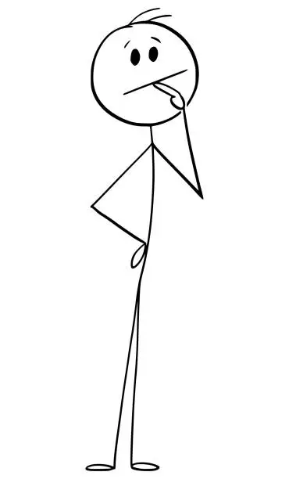
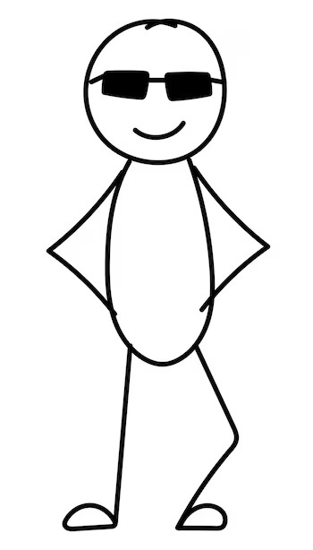
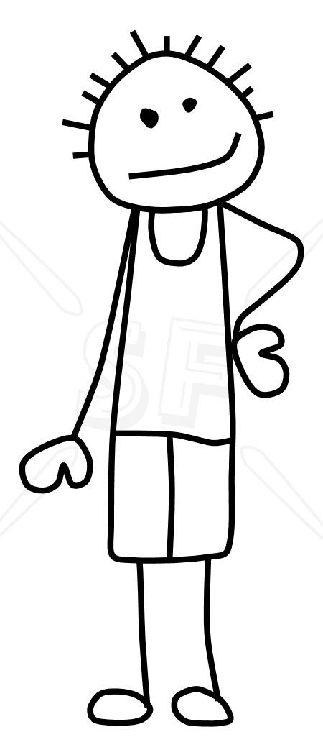




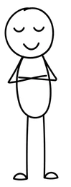



Eat or Be Eaten: A Game of Survival
Mr. Snack, the Lost Sailor
Who will end up eating him?
S
1
2
3
4
5
6
7
8
9
10
The Ten Cannibals
The Hierarchy
Common knowledge of
Rational

Slide 3

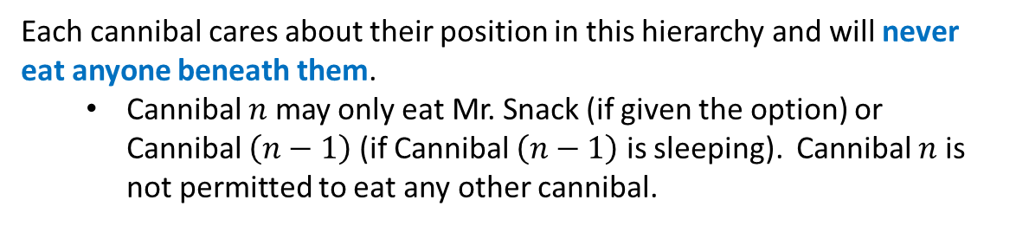
Ten Hungry Cannibals
Mr. Snack, the Lost Sailor, is stranded on an island with 10 rational cannibals.
The cannibals are ranked in a hierarchy of dominance, with Cannibal 1 being the most dominant, followed by Cannibal 2, and so on, down to Cannibal 10.
The cannibals take turns deciding whether to eat Mr. Snack, starting with Cannibal 1, who gets first dibs.
Each cannibal cares about their position in this hierarchy and will never eat anyone beneath them.
  Cannibal $n$ may only eat Mr. Snack (if given the option) or Cannibal $\left(n−1\right)$ (if Cannibal $\left(n−1\right)$ is sleeping). Cannibal $n$ is not permitted to eat any other cannibal.
If a cannibal eats, they will fall asleep, making them vulnerable to the next cannibal in line.
Who will dine?

